Slide 1
Lecture 5: Responsive Web Design

Slide 2
RWD: Questions over reading?
CH 12
Media Queries
Scaling
CH 14
Border radius
Adding shadows
Gradients
Opacity

Slide 3
RWD: Help
Media Queries
Viewport Tag
Perfect Full Page Background Image
W3School Responsive HTML
Stack Overflow Responsive

Slide 4
RWD: What is it
tl;dr
Responsive Web Design or RWD makes your web page look good on all devices (desktops, tablets, and phones)
“Responsive Web Design is the approach that suggest that design and development should respond to the user’s behavior and environment based on screen size, platform and orientation. The practice consists of a mix of flexible grids and layouts, images and an intelligent use of CSS media queries.” - Smashing Magazine

Slide 5
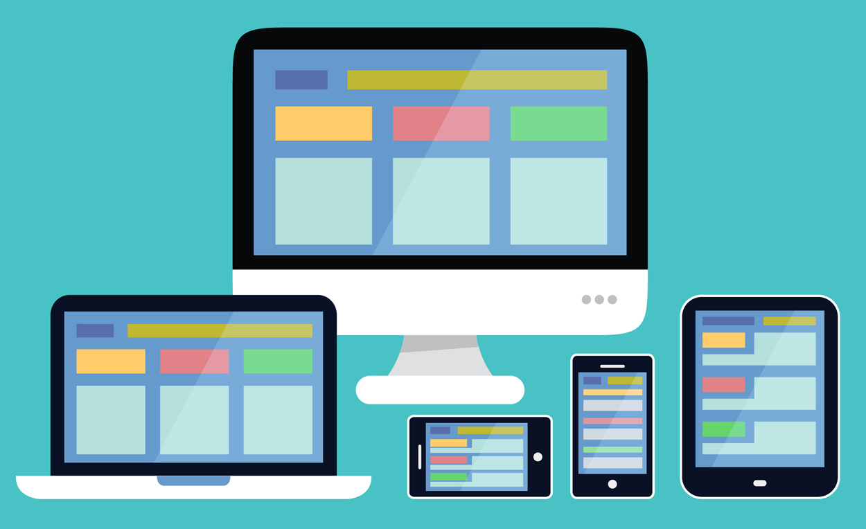
RWD: Example

Slide 6
RWD: How to develop for it?
tl;dr: Practice mobile first development (for purposes of this course we will be doing the opposite for varying reasons)
A good adage “when a user is on their phone looking at your site imagine they have one thumb and one eye”
Generally speaking those on a mobile device are more distracted and there for you want your content easily understood
Imagery over text
Bold simple actions over complex steps
When designing a website you’ll want to start small and add changes in as the screen size increases
“It is easier to add then it is to take away”

Slide 7
RWD: The purpose
The reason you want a Responsive site is that you want to serve 1 site that can be used by all your users
In the past mobile only sites were created like Mobile BART, the idea is to not have a dedicated sites to serve based on screen size. But 1 site for all devices
HTML is about accessibility for all and you can think of RWD the same way that no matter the device a user can take in your content

Slide 8
RWD: Popular Frameworks
Most all modern websites are built on some type of framework. These frameworks can be home grown or from 3rd parties. Many sites take advantage of different frameworks. These frameworks may or may not have grid systems. Here is a list of some popular Frameworks/grid systems
Twitter Bootstrap
uWatch
Foundation
Semantic UI
Skeleton
Materialize
GhostJack
Material UI (does not have grid system)
Flexbox Grid
Deftones Site
ReactWeather
Angular Material
Portfolio Site

Slide 9
Create Responsive Layout

Slide 10
RWD: Homework
Complete FULL InVision project
Prepare to present InVision project next week
Read Ch. 15

